Slide 1
10. Decentralized Applications (DApps, dApps)
Mastering Ethereum - Building Smart Contracts and DApps, 2018

Slide 2
Introduction
Smart contracts are a way to decentralize the controlling logic and payment functions of applications.
Web3 DApps are about decentralizing all aspects of an application: storage, messaging, naming, etc.

Slide 3
What is a DApp?
A DApp is an application that is mostly or entirely decentralized.
All the possible aspects of an application that may be decentralized:
Backend software (application logic)
Frontend software
Data storage
Message communications
Name resolution
Advantages to creating a DApp (comparing to a centralized one)
Resiliency, Transparency, Censorship resistance

Slide 4
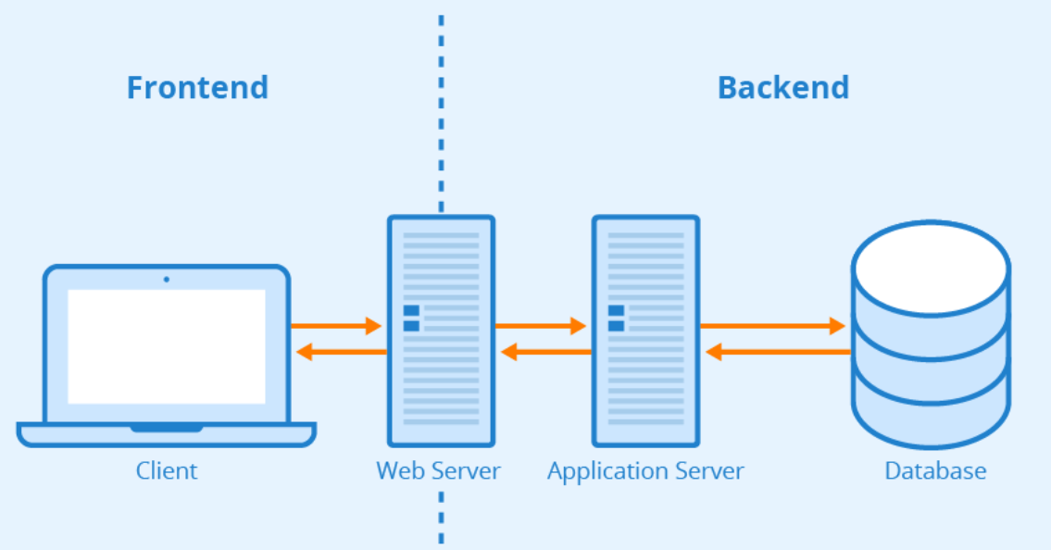
Frontend & Backend of Web 2.0 Applications

Slide 5
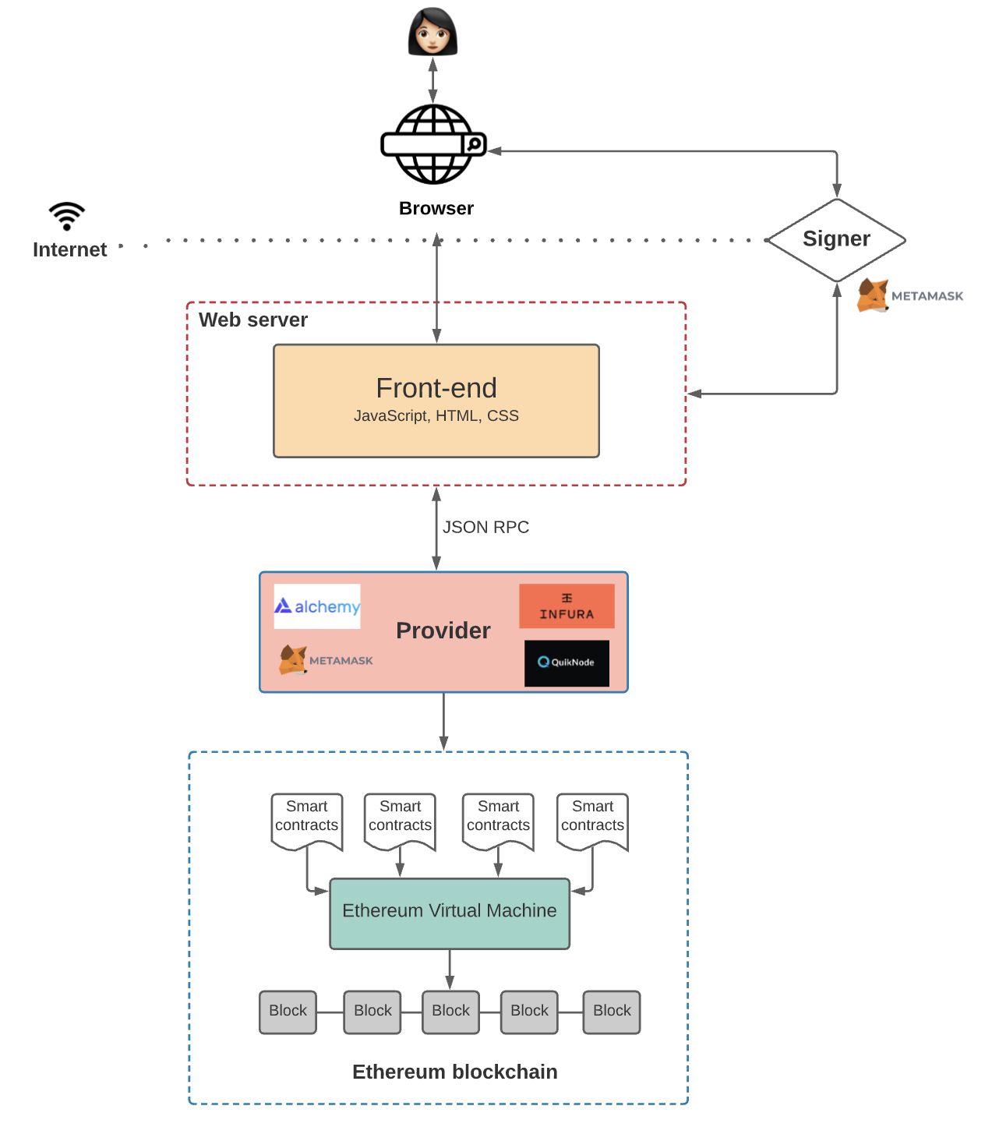
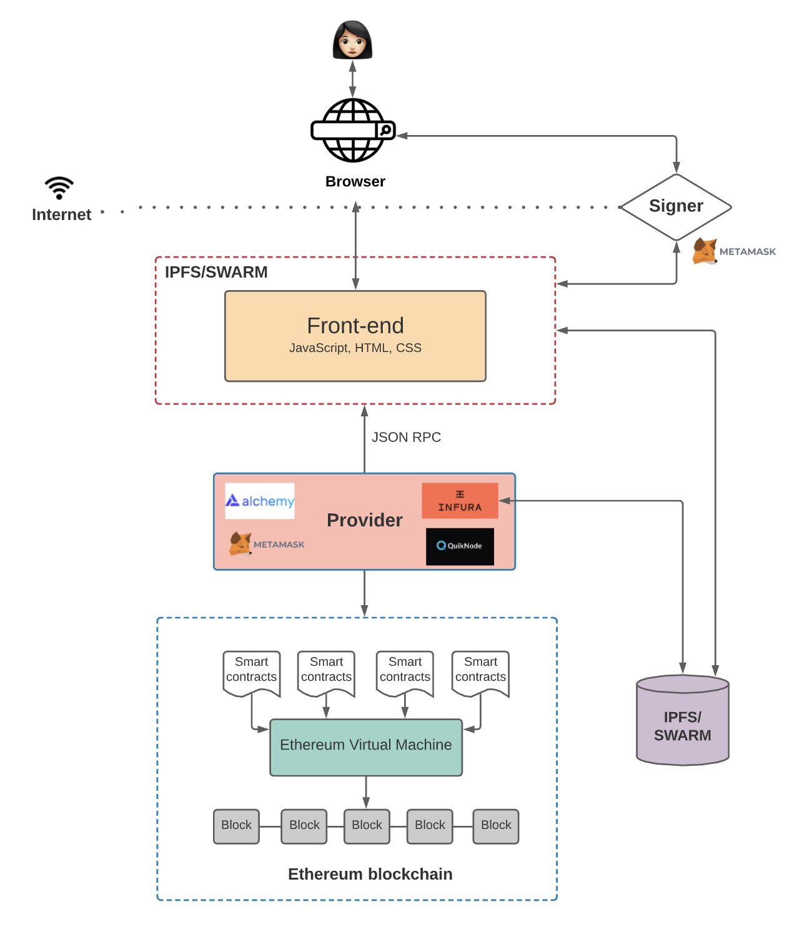
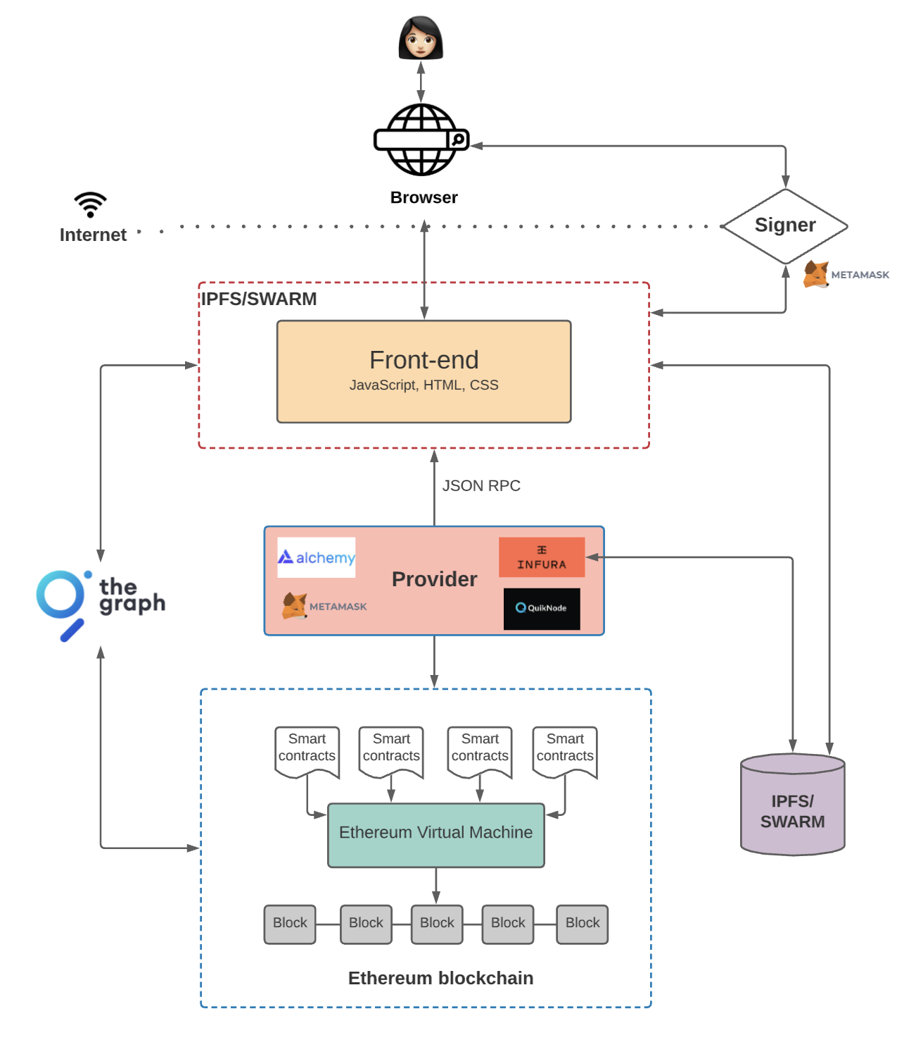
Web 3.0 Architecture
https://www.preethikasireddy.com/post/the-architecture-of-a-web-3-0-application

Slide 6
Backend (Smart Contract)
In a DApp, smart contracts are used to store the business logic (program code) and the related state of your application.
Think of a smart contract replacing a server-side (aka “backend”) component in a regular application.
Any computation executed in a smart contract is very expensive and so should be kept as minimal as possible.
It is therefore important to identify which aspects of the application need a trusted and decentralized execution platform.
Major considerations of smart contract architecture design
The inability to change the code of a smart contract once it is deployed.
A really large monolithic smart contract costs a lot of gas to deploy and use.

Slide 7
Frontend (Web User Interface)
The client-side interface of a DApp can use standard web technologies (HTML, CSS, JavaScript, etc.). This allows a traditional web developer to use familiar tools, libraries, and frameworks.
Interactions with Ethereum, such as signing messages, sending transactions, and managing keys, are often conducted through the web browser, via an extension such as MetaMask.
The frontend is usually linked to Ethereum via the web3.js JavaScript library, which is bundled with the frontend resources and served to a browser by a web server.

Slide 8
Data Storage
Due to high gas costs and the currently low block gas limit, smart contracts are not well suited to storing or processing large amounts of data.
Hence, most DApps utilize off-chain data storage services, meaning they store the bulky data off the Ethereum chain, on a data storage platform.
The data storage platform can be centralized (e.g. a cloud database), or the data can be decentralized, stored on a P2P platform such as the IPFS, or Ethereum’s own Swarm platform.
Decentralized P2P storage is ideal for storing and distributing large static assets such as images, videos, and the resources of the application’s frontend web interface (HTML, CSS, JavaScript, etc.).

Slide 9
Decentralized Message Communications Protocols
Another major component of any application is IPC (Inter-Process Communication).
That means being able to exchange messages between applications, between different instances of the application, or between users of the application.
Traditionally, this is achieved by reliance on a centralized server.
There are a variety of decentralized alternatives to server-based protocols, offering messaging over a P2P network.
The most notable P2P messaging protocol for DApps is Whisper, which is part of the Ethereum Foundation’s Go-Ethereum suite of tools.

Slide 10

The Ethereum Name Service (ENS) (1/3)
On the traditional internet, the Domain Name System (DNS) allows us to use human-readable names in the browser while resolving those names to IP addresses or other identifiers behind the scenes.
On the Ethereum blockchain, the Ethereum Name System/Service (ENS) solves the same problem, but in a decentralized manner.
ENS domains are secure domain names for the decentralized world.
ENS domains provide a way for users to map human readable names to blockchain and non-blockchain resources, like Ethereum addresses, IPFS hashes, or website URLs.
ENS domains can be bought and sold on secondary markets.
https://decrypt.co/resources/ethereum-name-service-ens-explained-guide-learn

Slide 11
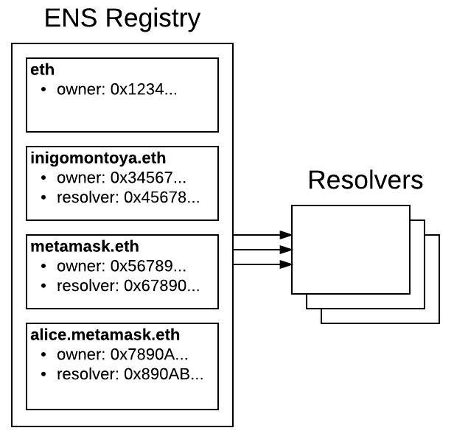
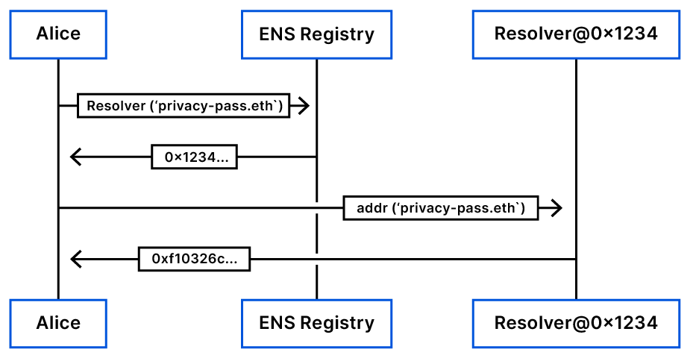
The Ethereum Name Service (ENS) (2/3)
Under the hood, ENS is basically two smart contracts:
The ENS registry records all the domains and subdomains, as well the owner’s details and the link to the Resolver, which is another smart contract that handles the translations from names to addresses or other types of resources and vice-versa.

Slide 12
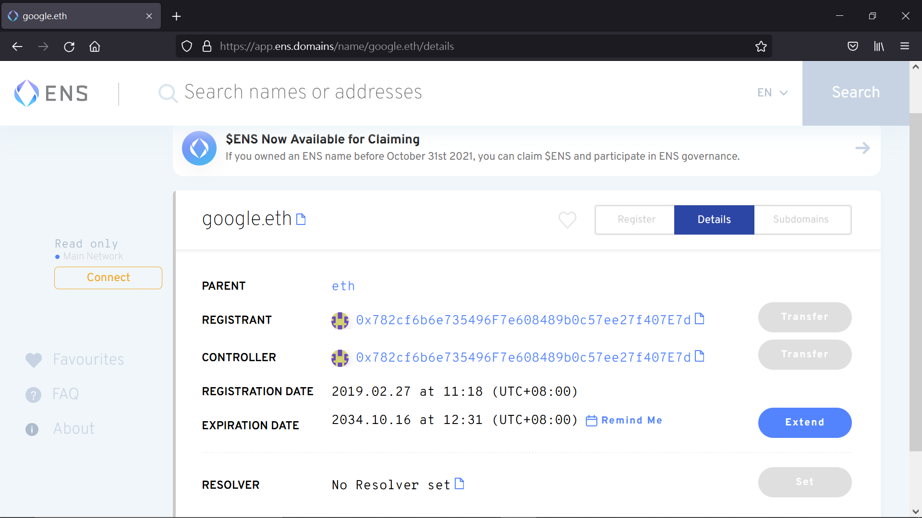
The Ethereum Name Service (ENS) (3/3)

Slide 13
Discussion on so-called Web3 & DApps
Ref. https://moxie.org/2022/01/07/web3-first-impressions.html
Does it make sense to decentralize everything?
The cryptocurrency world is the lack of attention to the client/server interface. When people talk about blockchains, they talk about distributed trust, leaderless consensus, and all the mechanics of how that works, but often gloss over the reality that clients ultimately can’t participate in those mechanics.
All the network diagrams are of servers, the trust model is between servers, everything is about servers. Blockchains are designed to be a network of peers, but not designed such that it’s really possible for your mobile device or your browser to be one of those peers.
Infura, Pinata, OpenSea, etc. are still websites with their own servers. The “distributedness” refers to where the state and the logic/permissions for updating the state lives: on the blockchain instead of in a “centralized” database.

